Slide 1
Exam Training
RHCSA – Exam Environment

Slide 2
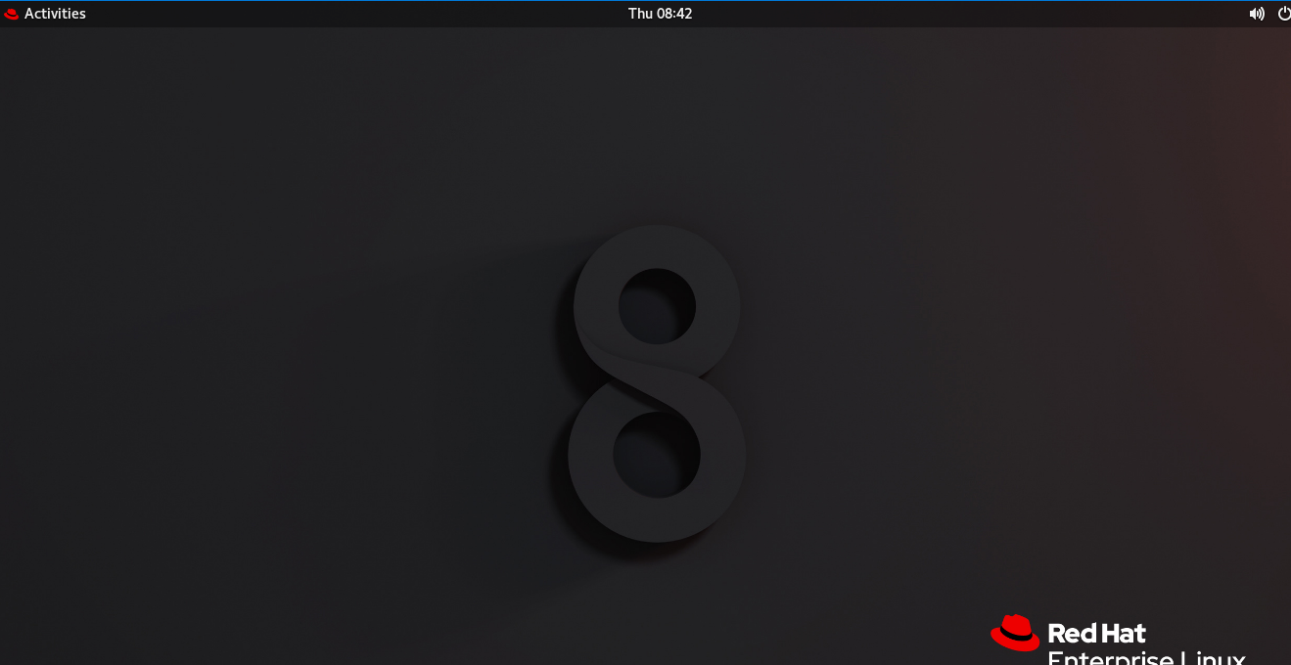
Exam Linux Environment
Click the
activities

Slide 3
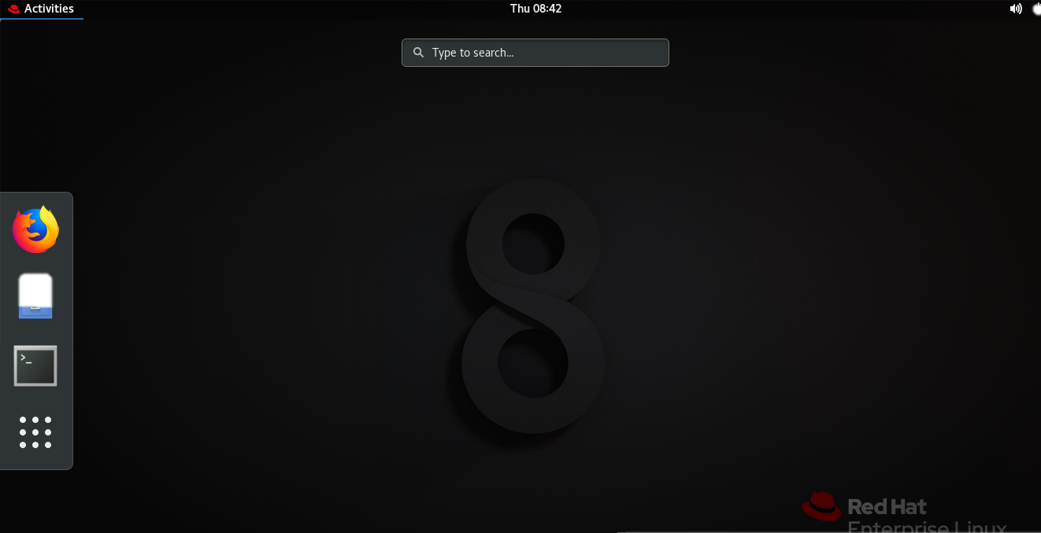


Exam Linux Environment
View Exam
VM Monitor
Terminal

Slide 4
Exam Linux Environment
Click this icon to open question paper

Slide 5
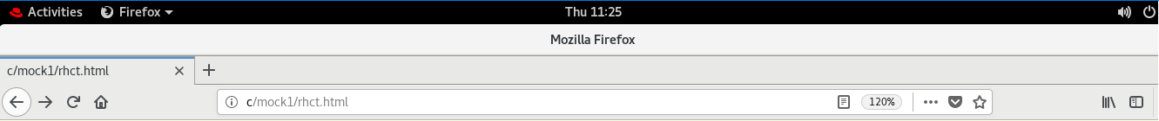
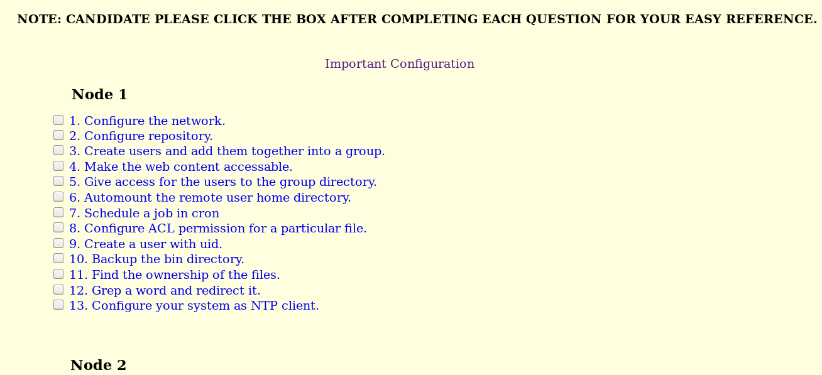
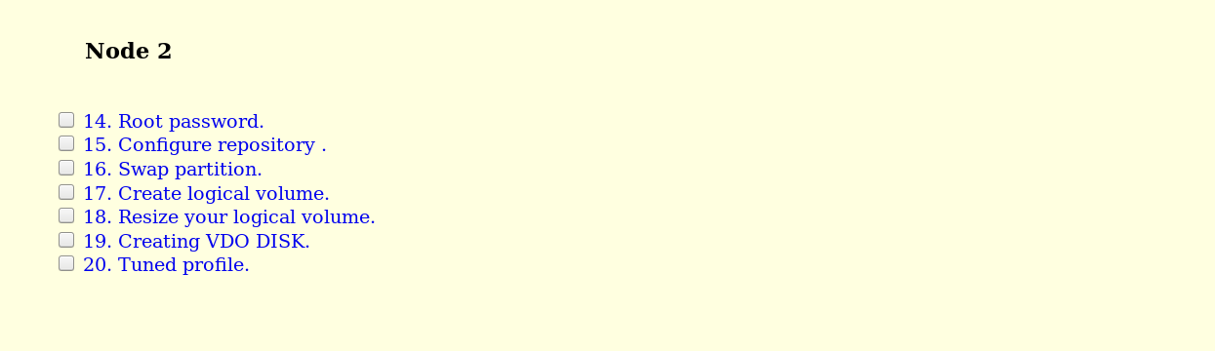
Click it to open initial setup page

Slide 6
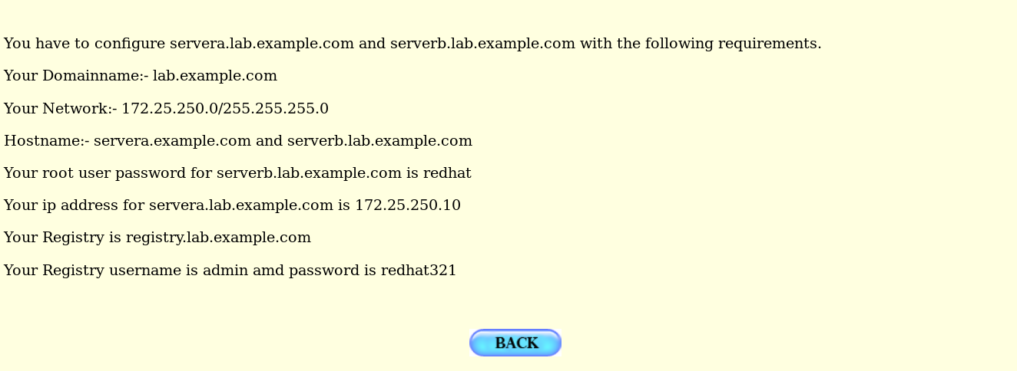

Slide 7
Click to VM monitor to open Virtual machines

Slide 8
Node1
Node2
Close
Click this to open node1 VM options

Slide 9
Status node1
Start node1
Stop node1
Poweroff node1
Reboot node1
Node1 Console
Click it to open node1 console
Reset node1
Close

Slide 10
